Slide 1
Hybrid Encryption Technique To Fortify Caesar Cipher
Team Details
P. Neetha Reddy(20EG105435)
M. Surya Teja (20EG105423)
Project Supervisor
B. Ravinder Reddy (Assistant Professor)

Slide 2
Introduction
The “Hybrid Encryption Technique to fortify caesar cipher” project is a combination of caesar cipher and rsa algorithm.
It helps the confidential information to be protected and the data transmitted is safeguarded.
With the encryption of the message using caesar cipher and ensuring further layer of security with RSA encryption, this project offers a great level of security against any kind of interceptions.

Slide 3
Problem Statement
Caesar cipher is one among the well known algorithm in Cryptography but it is vulnerable to brute force attack, frequency analysis attack, dictionary attack etc. many modern cryptographic algorithms have suggested improvement for caesar cipher but still failed to make it strong enough against attacks

Slide 4
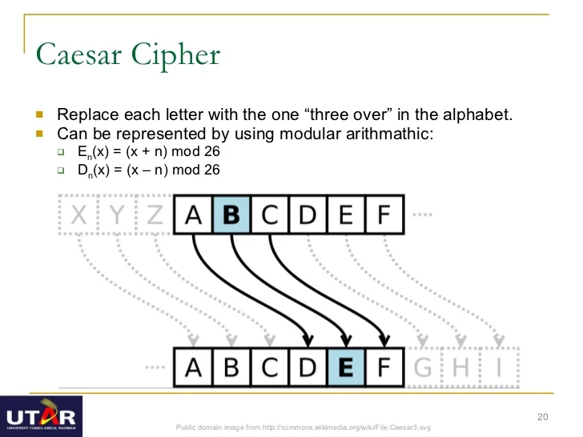
Caesar Cipher

Slide 5
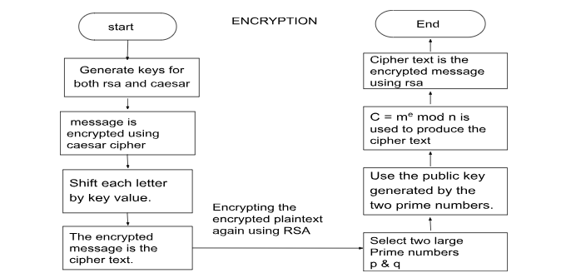
Proposed Method
The proposed method is “Hybrid Encryption Technique to fortify caesar cipher”.
INPUTS: Plaintext, large prime numbers(key).

Slide 6
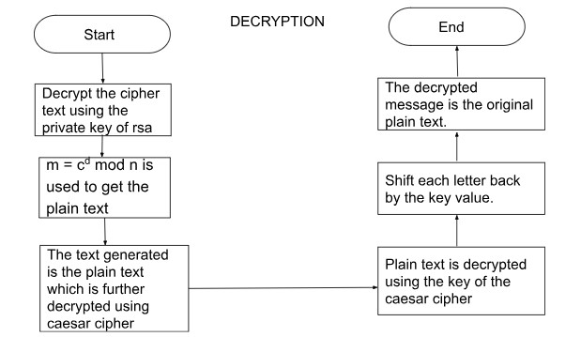
Proposed Method

Slide 7
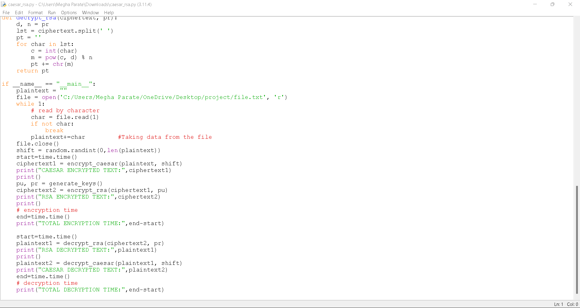
Experiment Environment
Experiment Environment used is IDLE
Used Random package for generating random number for shift value and public key.
Used time package to analyze encryption and decryption time.
Taking file input as the message to be sent.

Slide 8
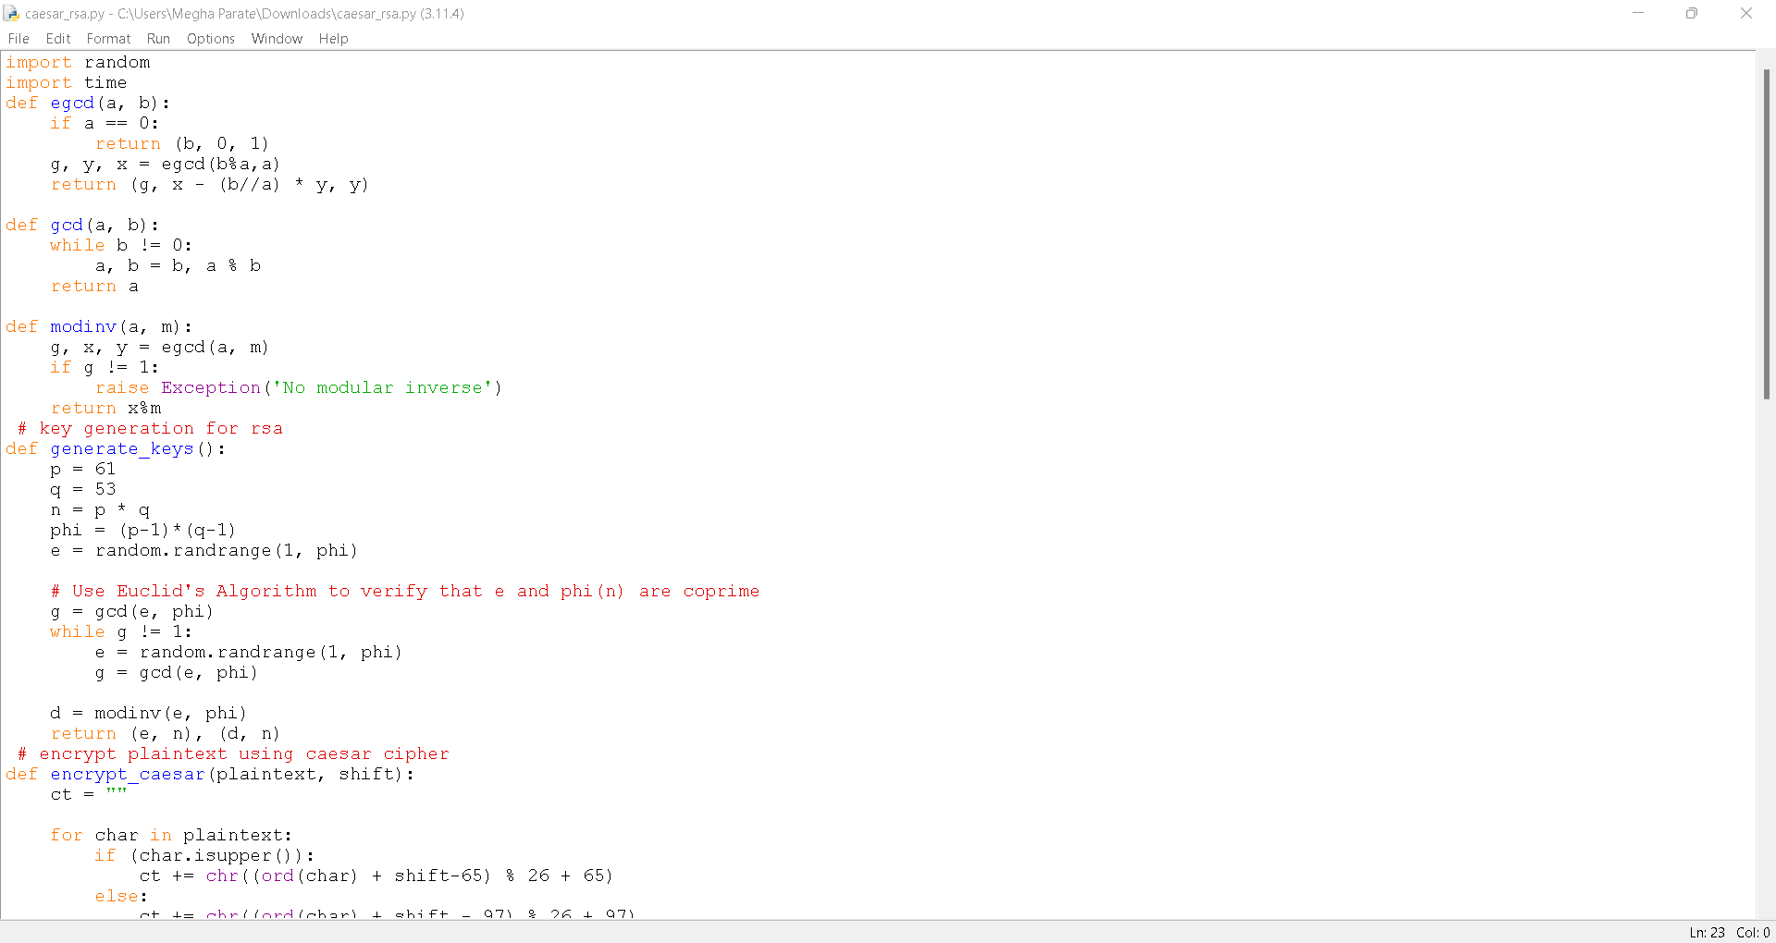
Experiment Screenshot

Slide 9
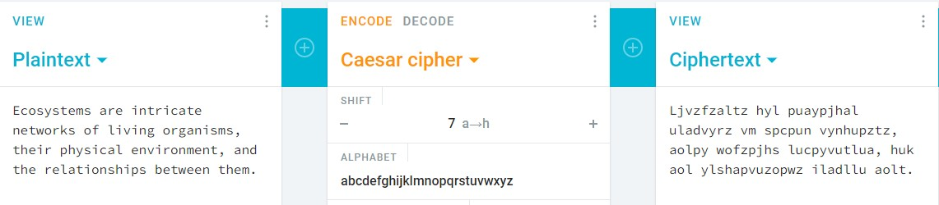
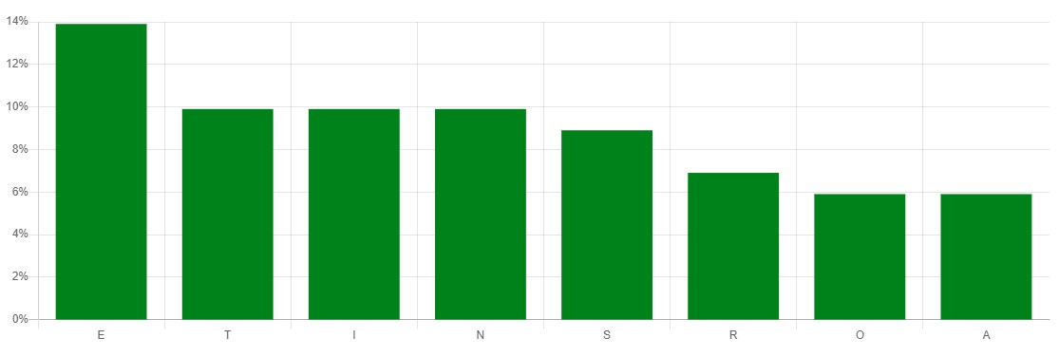
Experiment Screenshot
Frequency Analysis (Existing method)

Slide 10
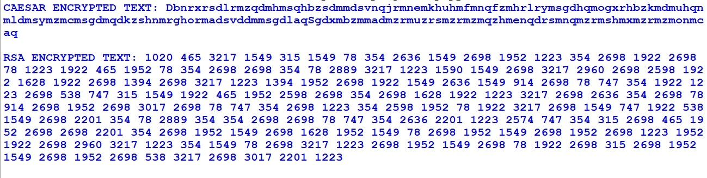
Experiment Screenshot
Frequency Analysis (proposed method)
Because it gives numeric values attack is not possible

Slide 11
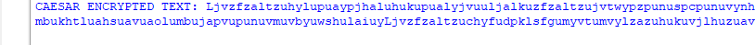
Experiment Screenshot
Dictionary Attack
The existing method is vulnerable to dictionary attack, as an attacker tries to decipher the ciphertext by trying all the known word combinations from a dictionary. In our proposed method the attack has been overridden as the ciphertext derived in our method is a numerical text.
Existing method
Proposed method

Slide 12
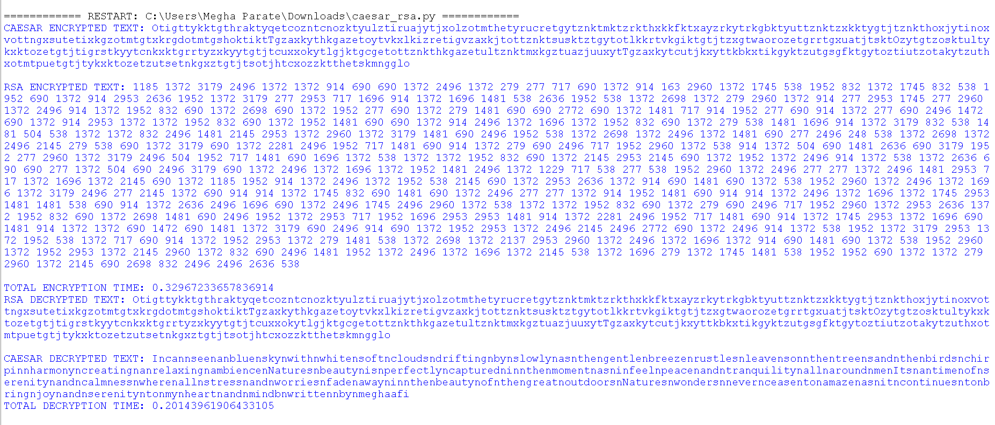
Experiment Results

Slide 13
Finding
We found that our hybrid cryptography system is secure against frequency analysis attack, ciphertext only attack, and dictionary attack .
The concept of randomised generation of shift value in Caesar cipher provides of an additional layer of security.
Due to double encryption using RSA it has been made difficult for an attacker to deduce the original plaintext.
Though the encryption and decryption time increases but it has overcome the attacks of Caesar Cipher.

Slide 14
Justification
Parameters | Mathematical Formula | Existing Value | Improved Value | Justification
Frequency Analysis Attack | Subgroup count(i) / total length of ciphertext | 0.948 | This attack on numerical data | The attack has been overcome as the data is converted into numeric format.
Ciphertext only Attack | Trying to decipher by analyzing the ciphertext with regularly used word list | Accurate guess of key length | Inaccurate guess of key Length | This attack cannot be performed as it uses large prime numbers.
Dictionary Attack | Trying all possible known words in dictionary order | 2.386 | Performing this attack on numeric data | This attack cannot be performed on numeric data.

